Slide 1
Aquaculture REST API
Presented to you by: Mustafa Alowda, Nasir Habad and Mohammad Arif Samadi

Slide 2
Project Background
This project is desigend for the aquaculture such as fish, seaweed, shellfish and other Aquatic lives
The main goal of this project is to develop a platform to manage and monitor aquaculture farms, such as fish farming, seaweed cultivation, shellfish farming and other types of Aquatic lives farming
The application is intened to be used by both end user and admin, the user can purchase aquaculture products while admin can manage the farms and the aquaculture products

Slide 3
Project Key Features
Admin:
Perform Login as an Admin
Admin can Manage(CRUD) Aquaculture Products(Fish,Seaweed,Shellfish)
Admin can Manage(CRUD) Aquaculture Farms (Fish Farming, Seaweed Cultivation,Shellfish Farming)
Admin can View the Transactions made by the user
Admin can Manage(CRUD) Topics/Articles/Tips
Admin can Manage (CRU) Farm Conditions (Temperature, Oxygen Level,pH) for each Aquaculture farm
Admin can Manage (CRU) Promo Codes for the users to Apply on their transactions

Slide 4
Project Key Features
User:
Perform Register/Login as a User
User can View Aquaculture Farms(Fish,Seaweed,Shellfish)
User can View Aquaculture Products (Fish Farming, Seaweed Cultivation,Shellfish Farming)
Users can Purchase Aquaculture Products and Make new Transactions
Users can View Topics/Articles/Tips
Users can View Farm Conditions (Temperature, Oxygen Level,pH) for each Aquaculture farm
Users can Apply Promo Codes for each Transaction

Slide 5
Use-Case Diagram
Use-Case Diagram

Slide 6
Tech Stack
Golang
Echo Framework
Gorm
Echo JWT middleware
Echo Logger middleware
Validator
Vektra's Mockery
Testify/Assert
Viper
Docker
Koyeb
Supabase

Slide 7
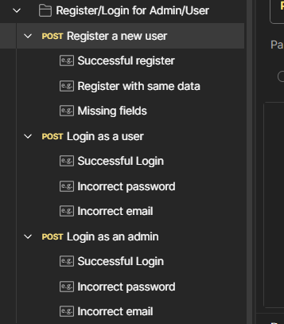
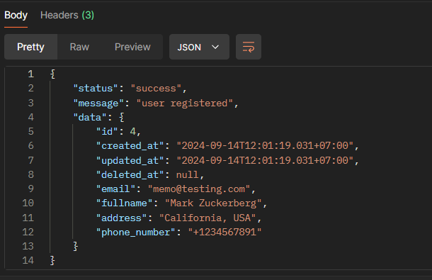
API Documentation
Perform Registration/Login Successful Registration

Slide 8
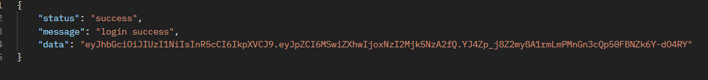
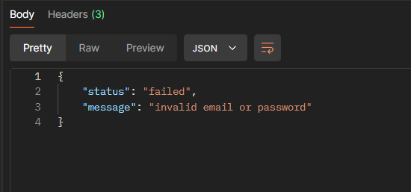
API Documentation
Successful Login Attempt
Failed Login Attempt

Slide 9
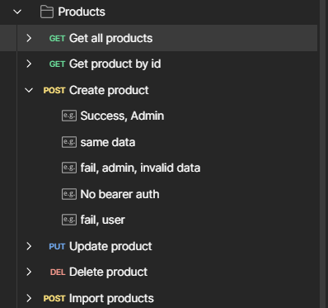
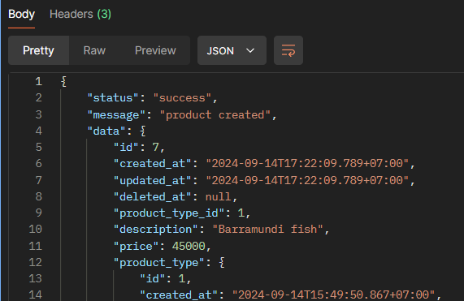
API Documentation
Create Products Requests Create Product Successful

Slide 10
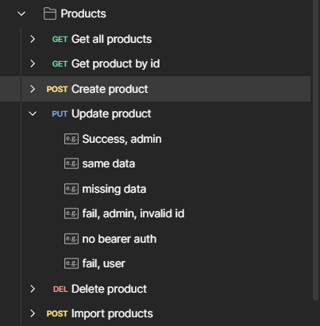
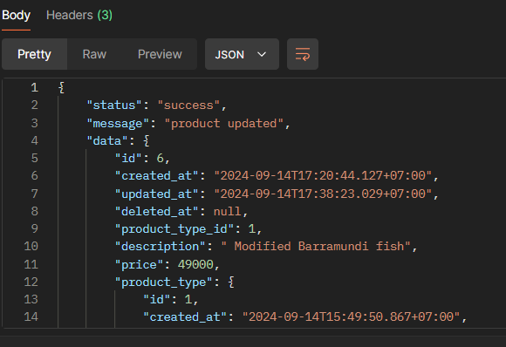
API Documentation
Update Product Update Product Successful

Slide 11
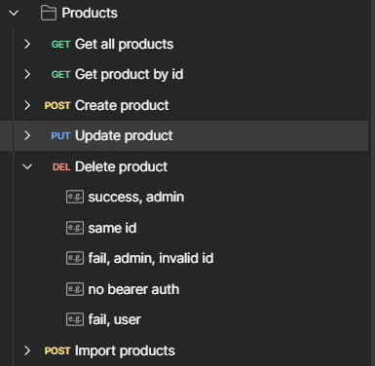
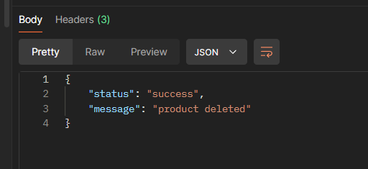
API Documentation
Delete Product Delete Product Successful

Slide 12
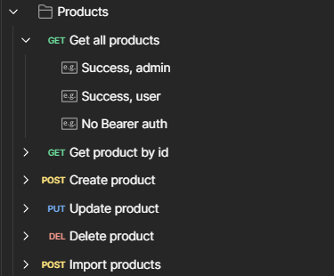
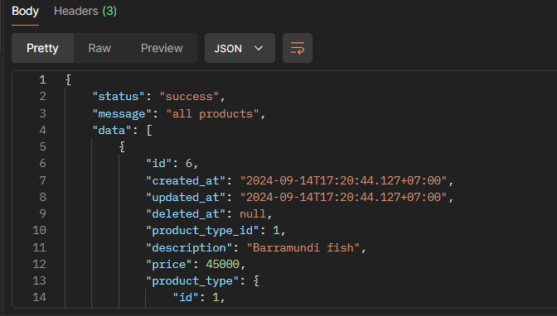
API Documentation
Get all Products Product Retrieval Successful

Slide 13
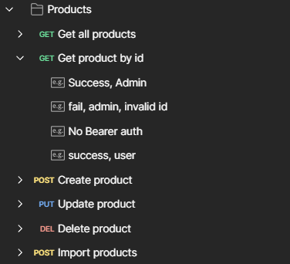
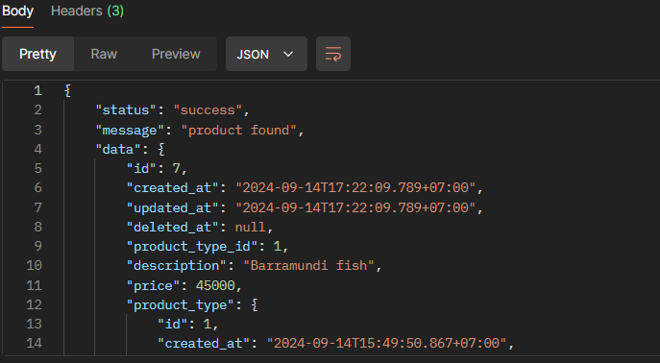
API Documentation
Get Product by ID Product Retrieval by ID Successful

Slide 14
API Documentation
For Full API Documentation Cases/Responses Click Here

Slide 15
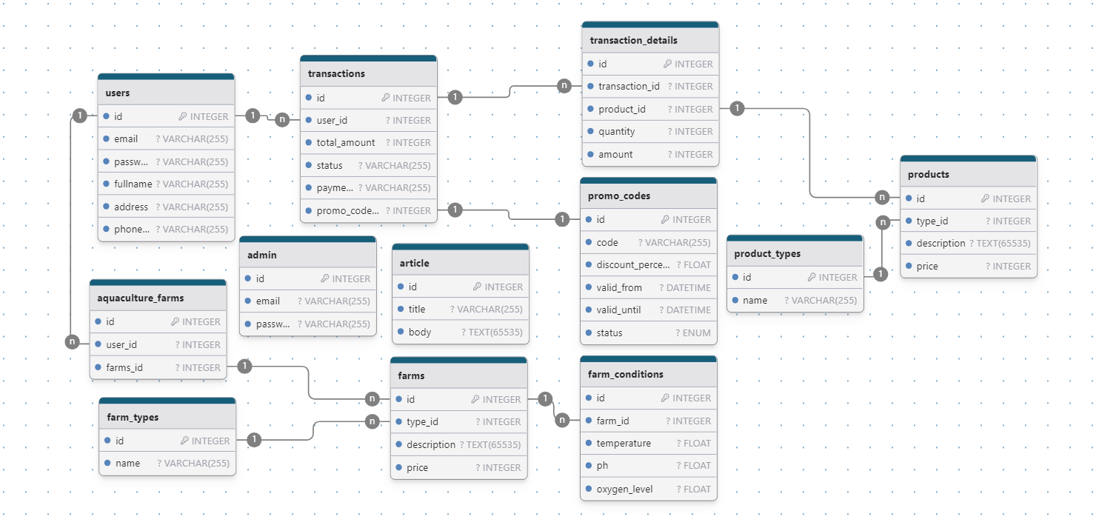
ERD Design

Slide 16
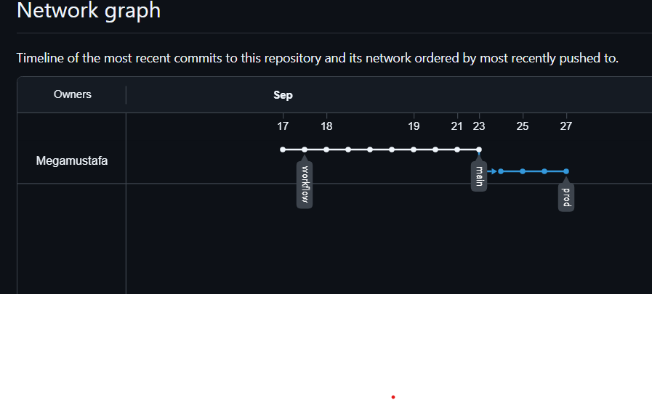
Git Workflow
Explain the Git workflow when developing a project.

Slide 17
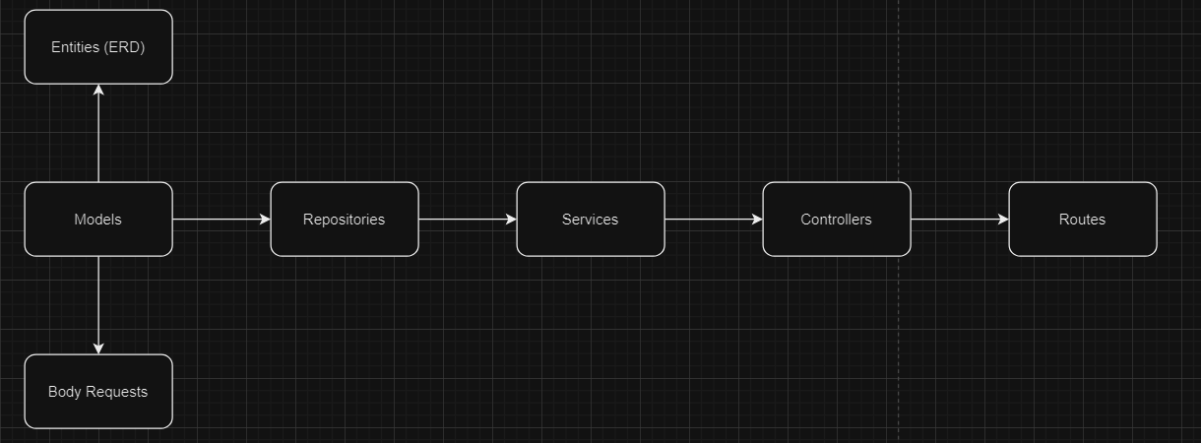
Demo
We used MVC architecture REST API to implement the core features for the project’s main features

Slide 18
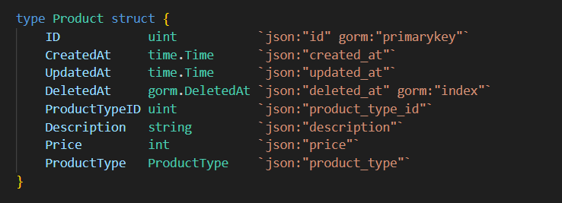
Demo
Models

Slide 19
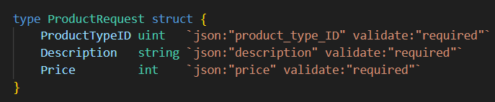
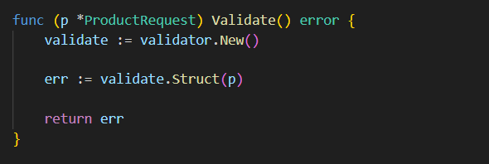
Demo
2) Body Requests (For Create and Update Methods)
Validator Tech (for ProductRequest validations)

Slide 20
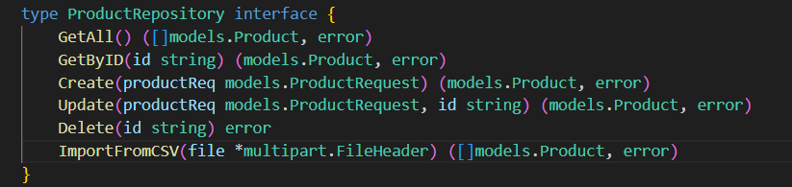
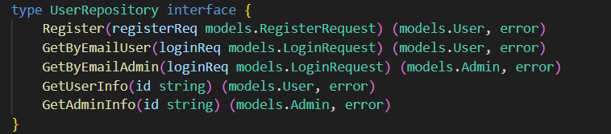
Demo
3) Repositories

Slide 21
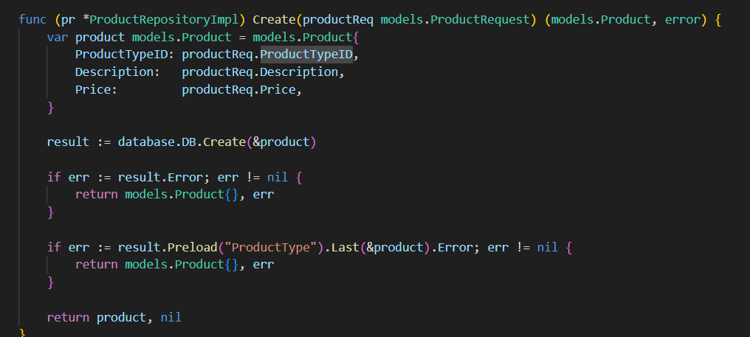
Demo
3) Repositories (continued)

Slide 22
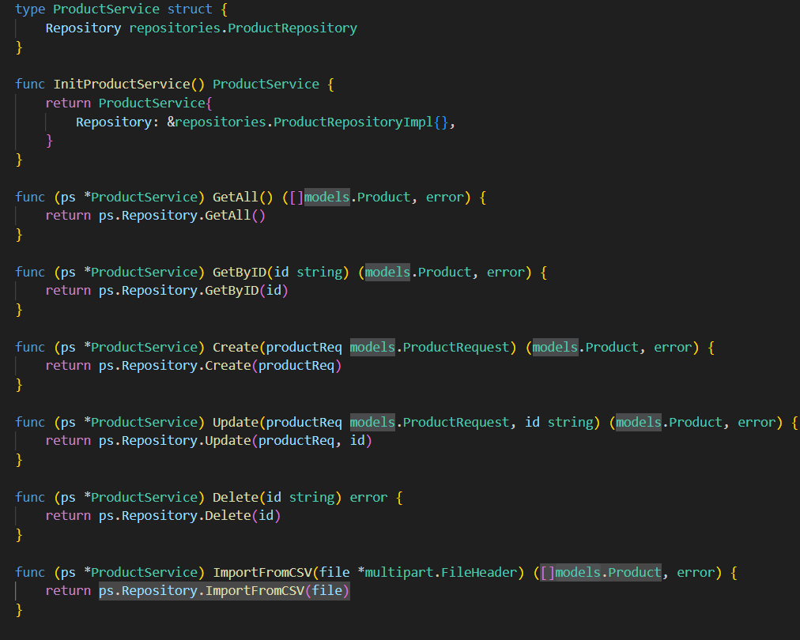
Demo
4) Services

Slide 23
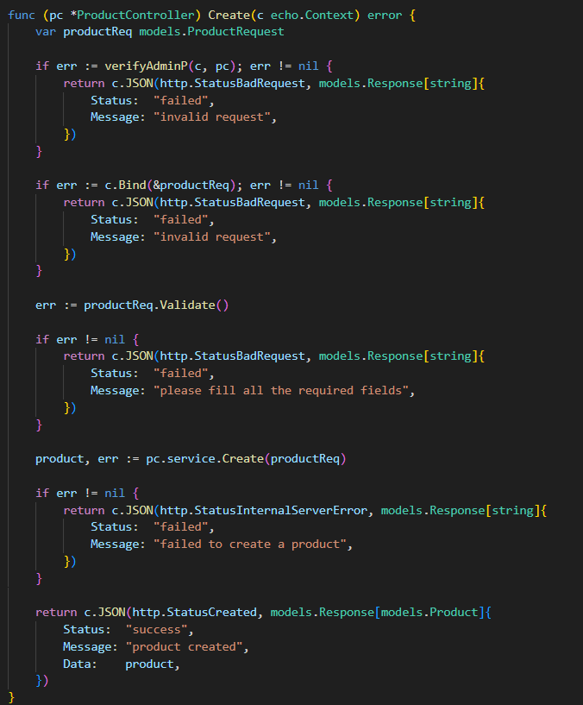
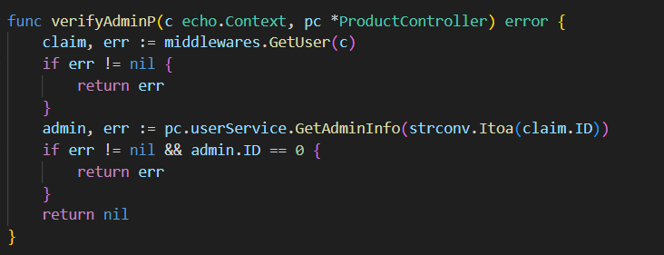
Demo
5) Controllers Admin Verification

Slide 24
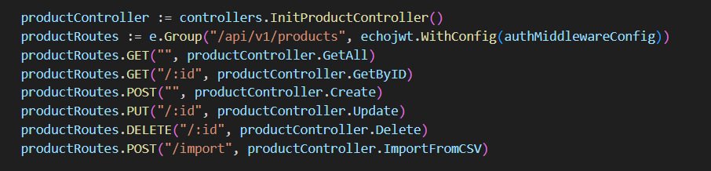
Demo
6) Routes

Slide 25
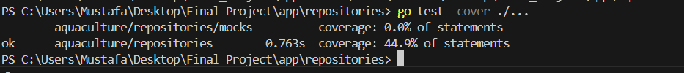
Unit Test Result
After Performing Unit Testing for All methods in the Repositories we made sure to test all Methods for both Valid Cases and Invalid Cases
Test Coverage results
Based on the Testing Results we think that some improvements needed for our testing to make a full coverage

Slide 26
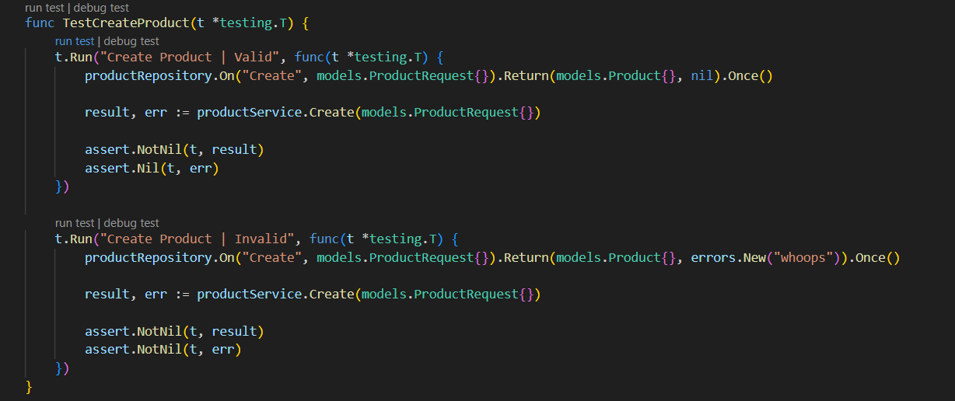
Unit Test Result
Example for Unit Test for Create Product Method

Slide 27
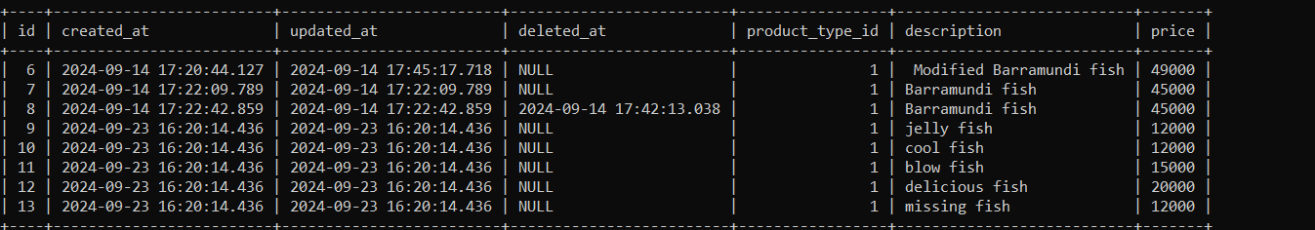
Future Works
The coding for this project is far from perfect
Some known Issues:
The gorm model used in the models records ID even if the request fails
When adding new items to the entity the ID does not replace ID that doesn’t have any values

Slide 28
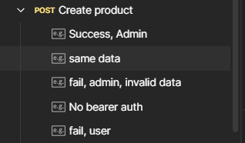
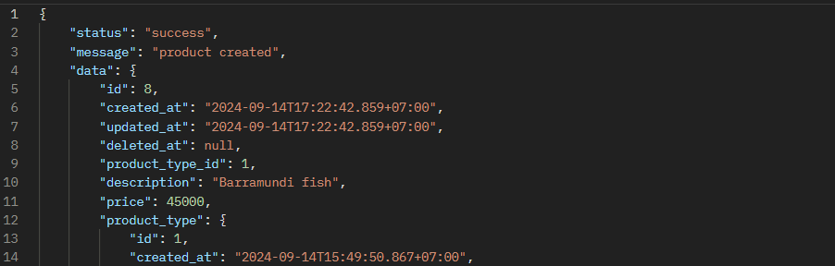
Future Works
Some known Issues:
3) Sometimes when adding items with similar data the request succeed

Slide 29
Future Works
Future Works/Improvements to be made:
Fixing the Gorm model to make new Items/Entries be added on the most recent ID
Adding new features like (Reset Password) for forgotten passwords or update account info for the user
Making Data unique for each entries for each entity by using `gorm:”unique”`
In the models

Slide 30
Thank You
Aquaculture REST API/ Team No.3

